Slide 1
Machine Learning Techniques:
Learning from Examples
Chapter 18

Slide 2
Outline
Learning agents
Inductive learning
Decision tree learning

Slide 3
Learning
Learning is essential for unknown environments,
  i.e., when designer lacks omniscience
Learning is useful as a system construction method,
  i.e., expose the agent to reality rather than trying to write it down
Learning modifies the agent's decision-making mechanisms to improve performance

Slide 4
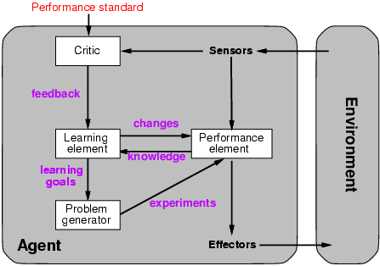
Learning agents

Slide 5
Learning element
Design of a learning element is affected by
  Which components of the performance element are to be improved
  What feedback is available to learn these components
  What representation is used for the components
  What prior knowledge is available
Type of feedback:
  Supervised learning: correct answers for each example
  Unsupervised learning: correct answers not given
  Reinforcement learning: occasional rewards

Slide 6
Inductive learning
A type of deterministic supervised learning
Simplest form: learn a function from examples
f is the target function
An example is a pair (x, f(x))
Problem: find a hypothesis h
  such that h ≈ f
  given a training set of examples
This is a highly simplified model of real learning:
  Ignores prior knowledge
  Assumes examples are given
  Assumes that the agent wants to learn f

Slide 7
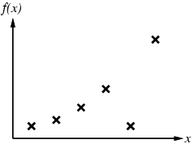
Inductive learning method
Construct/adjust h to agree with f on training set
(h is consistent if it agrees with f on all examples)
E.g., curve fitting:

Slide 8
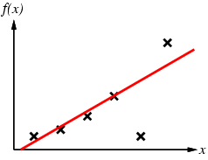
Inductive learning method
Construct/adjust h to agree with f on training set
(h is consistent if it agrees with f on all examples)
E.g., curve fitting:

Slide 9
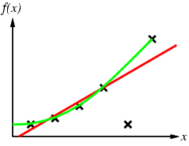
Inductive learning method
Construct/adjust h to agree with f on training set
(h is consistent if it agrees with f on all examples)
E.g., curve fitting:

Slide 10
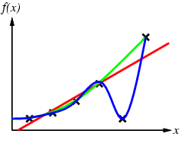
Inductive learning method
Construct/adjust h to agree with f on training set
(h is consistent if it agrees with f on all examples)
E.g., curve fitting:

Slide 11
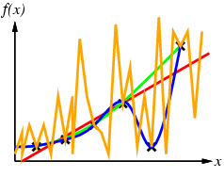
Inductive learning method
Construct/adjust h to agree with f on training set
(h is consistent if it agrees with f on all examples)
E.g., curve fitting:

Slide 12
Inductive learning method
Construct/adjust h to agree with f on training set
(h is consistent if it agrees with f on all examples)
E.g., curve fitting:
Ockham’s razor: prefer the simplest hypothesis consistent with data

Slide 13
Learning decision trees
Decision tree - returns a decision (predicted output) for each example
  Examples represented by sets of attribute values
  Each internal node is an attribute test
  Each leaf node specifies value returned
Classification learning – learning a discrete-valued function
  Boolean classification – examples are classified as true/false
Regression learning – learning a continuous function

Slide 14
Learning decision trees
Problem: decide whether to wait for a table at a restaurant
First step: determine the attributes used to describe examples:
  Alternate: is there an alternative restaurant nearby?
  Bar: is there a comfortable bar area to wait in?
  Fri/Sat: is today Friday or Saturday?
  Hungry: are we hungry?
  Patrons: number of people in the restaurant (None, Some, Full)
  Price: price range ($, $$, $$$)
  Raining: is it raining outside?
  Reservation: have we made a reservation?
  Type: kind of restaurant (French, Italian, Thai, Burger)
  WaitEstimate: estimated waiting time (0-10, 10-30, 30-60, >60)

Slide 15
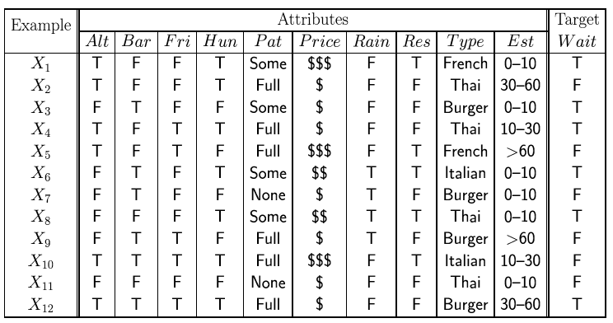
Attribute-based representations
Examples described by attribute values
Example situations where I will/won't wait for a table:
Classification of examples is positive (T) or negative (F)

Slide 16
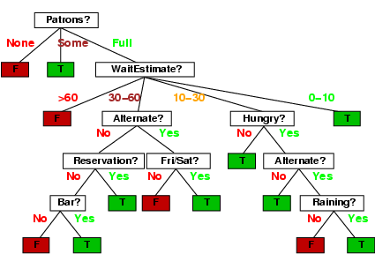
Decision trees
One possible representation for hypotheses
E.g., here is the “true” tree for deciding whether or not to wait:

Slide 17
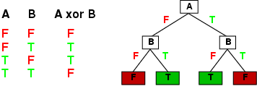
Expressiveness
Decision trees can express any function of the input attributes.
E.g., for Boolean functions, truth table row → path to leaf:
Trivially, there is a consistent decision tree for any training set with one path to a leaf for each example (unless f nondeterministic in x) but it probably won't generalize to new examples
Prefer to find more compact decision trees

Slide 18
Hypothesis space
How many distinct decision trees with n Boolean attributes?
Each truth table has 2^{n} rows
Each function can be represented as a 2^{n}-bit answer
Number of different functions or decision trees for n attributes
= number of distinct truth tables with 2^{n} rows = 2^{2n}
E.g., with 6 Boolean attributes, there are 18,446,744,073,709,551,616 trees!
Need a good algorithm to find consistent hypotheses in such a large space

Slide 19
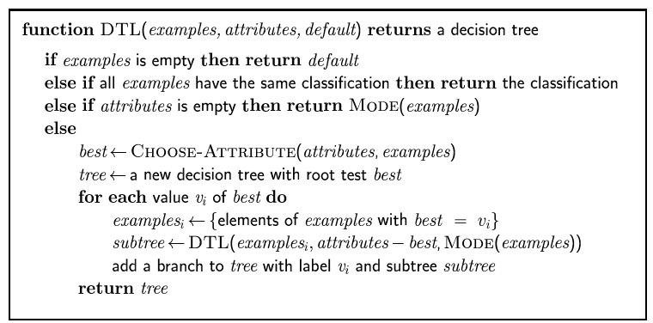
Decision tree learning
Aim: find a small tree consistent with the training examples
Idea: (recursively) choose "most significant" attribute as root of (sub)tree

Slide 20
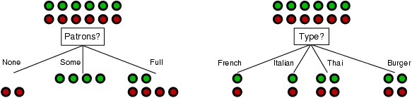
Choosing an attribute
Idea: a good attribute splits the examples into subsets that are (ideally) "all positive" or "all negative"
Patrons is a better choice – gives information about the classification

Slide 21
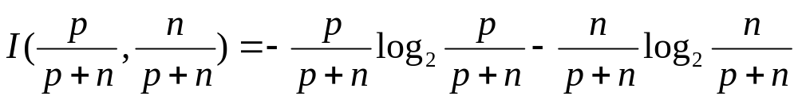
Using information theory
Measures information content in bits
Can be used to implement Choose-Attribute in the DTL algorithm
Given possible answers, v_{i} with probabilities, P(v_{i}), information content I or entropy of answer is:
I(P(v₁), … , P(v_{n})) = Σ_{i=1} -P(v_{i}) log₂ P(v_{i})
For a training set containing p positive examples and n negative examples:

Slide 22
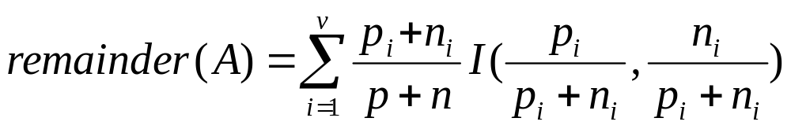
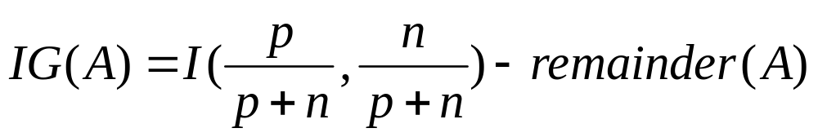
Information gain
A chosen attribute A divides the training set E into subsets E₁, … , E_{v} according to their values for A, where A has v distinct values
Information needed to classify example after testing A is:
Information Gain (IG) from the attribute test on A:
Choose the attribute with the largest IG

Slide 23
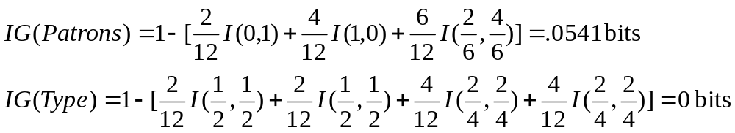
Information gain
For the training set, p = n = 6, I(6/12, 6/12) = 1 bit
Consider the attributes Patrons and Type:
Patrons has the highest IG of all attributes and so is chosen by the DTL algorithm as the root of the tree

Slide 24
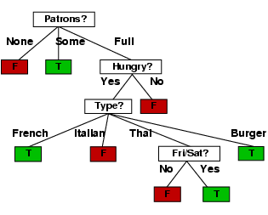
Example contd.
Decision tree learned from the 12 examples:
Substantially simpler than “true” tree---a more complex hypothesis isn’t justified by small amount of data

Slide 25
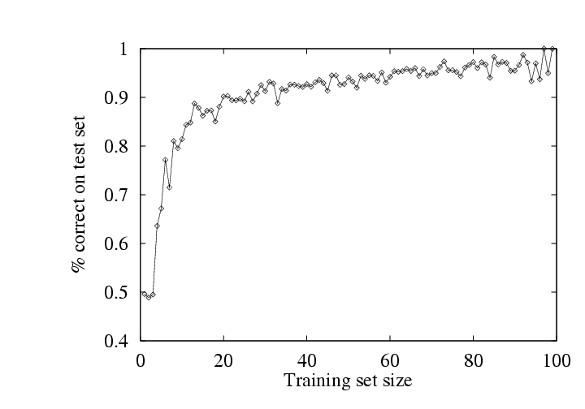
Performance measurement
How do we know how well h ≈ f ?
  Use theorems of computational/statistical learning theory
  Try h on a new test set of examples
  (use same distribution over example space as training set)
Learning curve = % correct on test set as a function of training set size

Slide 26
Summary
Learning needed for unknown environments or lazy designers
Learning agent = performance element + learning element
For supervised learning, the aim is to find a simple hypothesis approximately consistent with training examples
Example: decision tree learning using information gain
Learning performance = accuracy measured on test set

